Slide 1



Growth mind-set through Resilient Intelligent Technologies
Funded by the European Union. Views and opinions expressed are however those of the author(s) only and do not necessarily reflect those of the European Union or the European Education and Culture Executive Agency (EACEA). Neither the European Union nor EACEA can be held responsible for them.

Slide 2

Stakeholders

Slide 3

Stakeholders
Regardless of which category they fall into, the changes our society needs are made by people. In this chapter, we describe the main tasks that students, teachers, researchers, staff, employers and policymakers need to accomplish in order to bring about real change in university life.

Slide 4
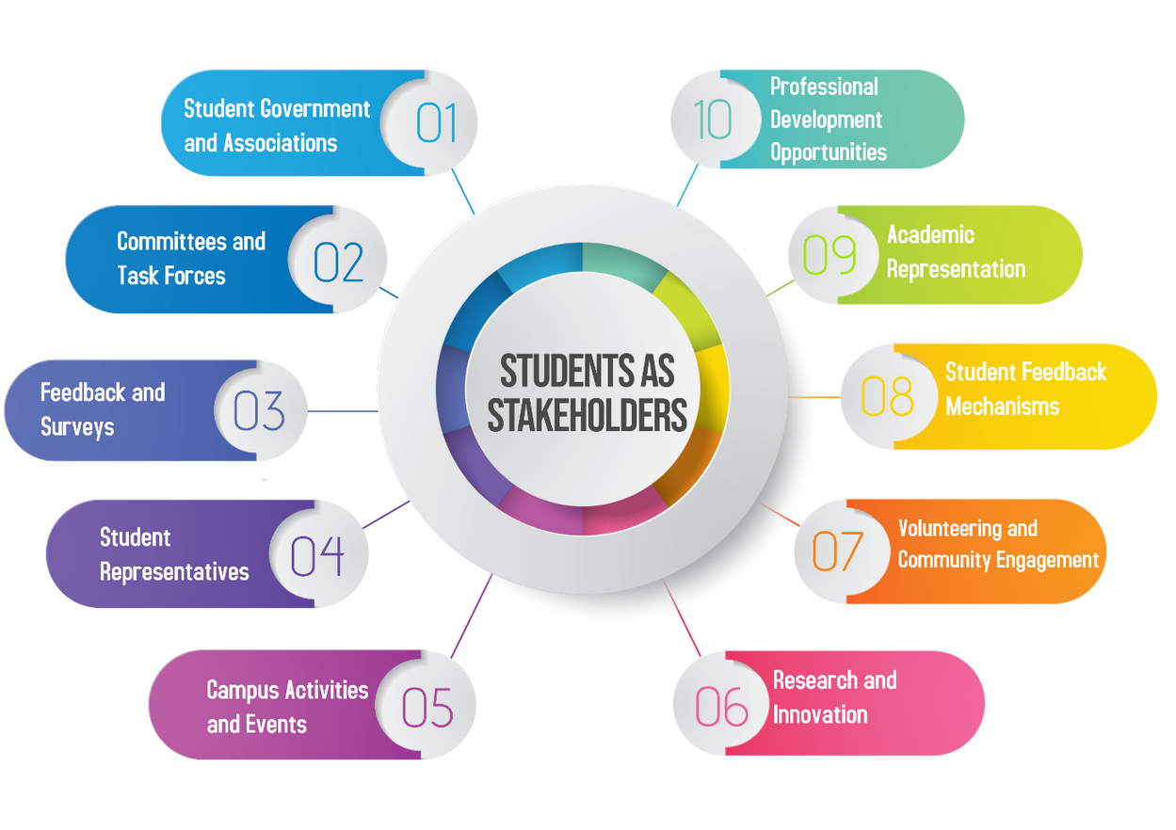
Students
as stakeholders

Slide 5
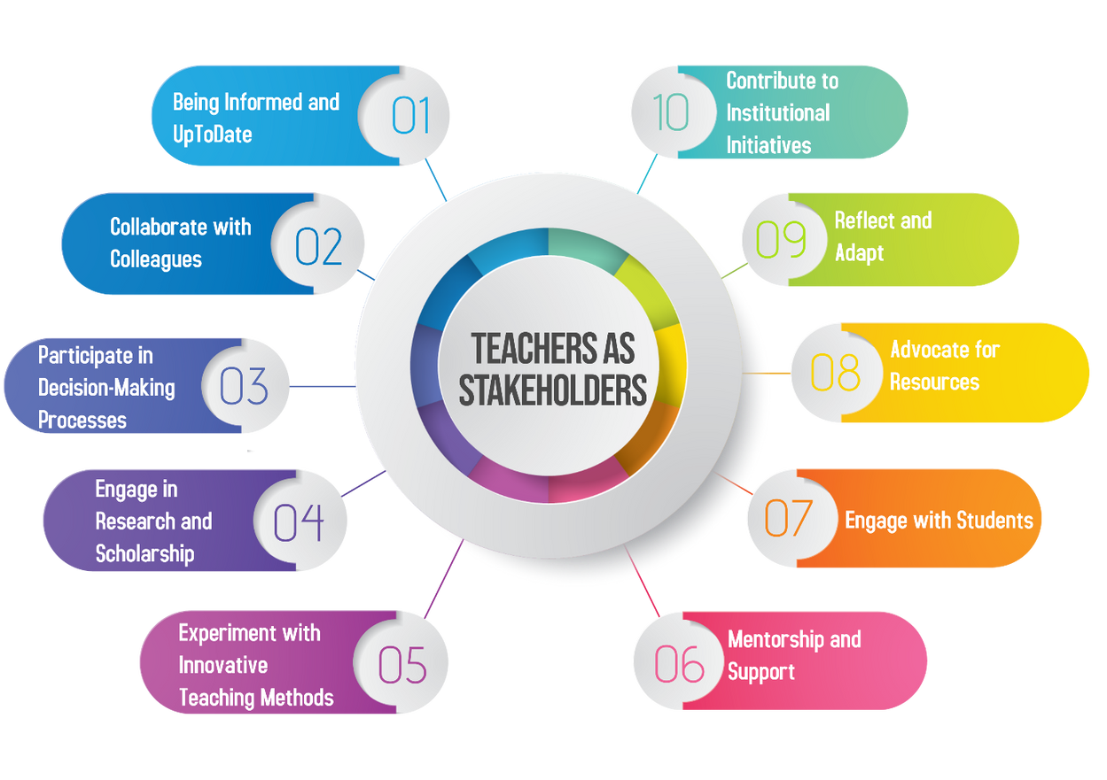
Teachers
as stakeholders

Slide 6

Researchers
as
stakeholders

Slide 7


